Slide 1
ICT407: IT Governance in Organisations
Week 10:
Lecturer: Dr. Farshid Keivanian

Slide 2
Change Management Principles
Introduction
Change management is a structured approach that helps manage changes in an organization’s IT infrastructure, ensuring smooth implementation with minimal risks.

Slide 3
Change Management Principles
Practical Scenario Presentation
Imagine you work for Telstra, a leading telecommunications company in Sydney. They’re planning to upgrade their customer management system. This change affects multiple departments, and there's concern about the potential disruptions it may cause.
Class Discussion Question
How would you plan for this change to ensure minimal disruption and successful adoption?

Slide 4
Change Management Principles
Responses:
Develop a step-by-step plan considering the impact on technology, people, and processes.
Communicate the benefits and any disruptions in advance.
Train employees to adapt to the new system.
Multiple-Choice Question
Which of the following is a key principle of change management?
A) Ignoring employee concerns B) Planning thoroughly C) Rushing implementation D) Avoiding communication

Slide 5
IT Governance Principles
Introduction
IT governance ensures that an organization’s IT operations align with its strategic goals, risks are managed, and resources are optimized.

Slide 6
IT Governance Principles
Practical Scenario Presentation
You are a part of Commonwealth Bank's IT team in Melbourne. The bank wants to implement a new online banking feature. However, this must be done while ensuring data security and compliance with regulations.
Class Discussion Question
How would you apply IT governance principles to implement this change?

Slide 7
IT Governance Principles
Responses:
Align the new feature with business goals (Strategic Alignment).
Identify potential security risks (Risk Management).
Measure the success of the implementation (Performance Measurement).

Slide 8
Kotter’s 8-Step Model
Introduction
Kotter’s model outlines eight essential steps to lead successful change, from creating urgency to embedding changes into the culture.

Slide 9
Kotter’s 8-Step Model
Practical Scenario Presentation
Your team at Sydney Water is introducing an automated billing system. Resistance is expected from some staff who are used to the manual process.
Class Discussion Question
What steps from Kotter's model could help ensure this change is successful?

Slide 10
Kotter’s 8-Step Model
Responses:
Create a sense of urgency by highlighting the benefits.
Form a coalition of change champions.
Communicate the vision clearly and repeatedly.

Slide 11
Common Reasons for Resistance
Introduction
Employees often resist change due to fear of the unknown, loss of control, or perceived negative impacts.

Slide 12
Common Reasons for Resistance
Practical Scenario Presentation
At Qantas Airways, a new software is being introduced for scheduling flights. Many employees are anxious about losing their current roles.
Class Discussion Question
How would you address this resistance effectively?

Slide 13
Common Reasons for Resistance
Responses:
Provide clear communication about how the software benefits both employees and customers.
Involve employees in the transition process to reduce fear.
Multiple-Choice Question
What is a common reason for resistance to change?
A) Clear communication B) Increased workload C) Familiarity D) Comfort zone

Slide 14
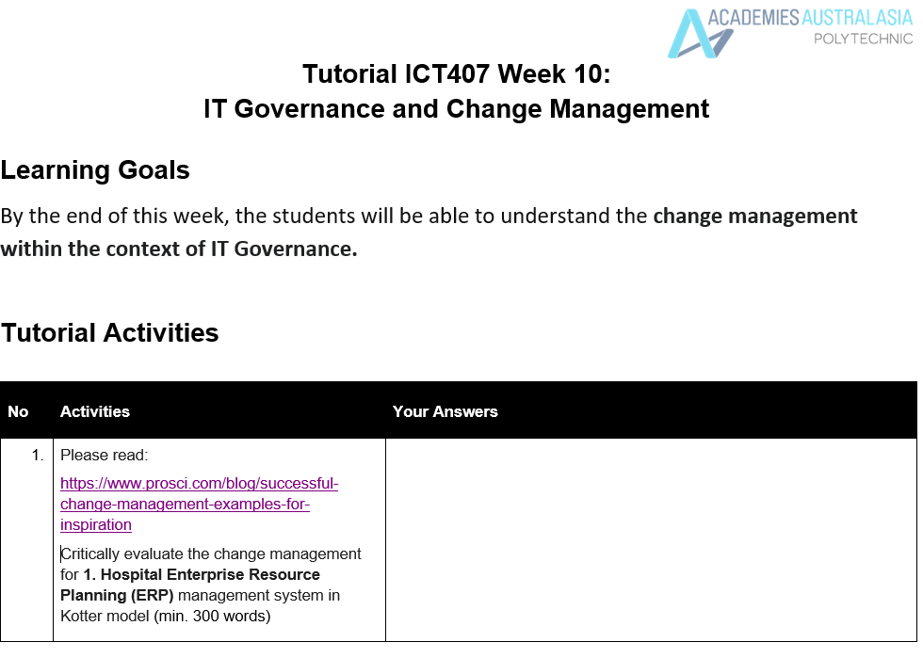

Slide 15
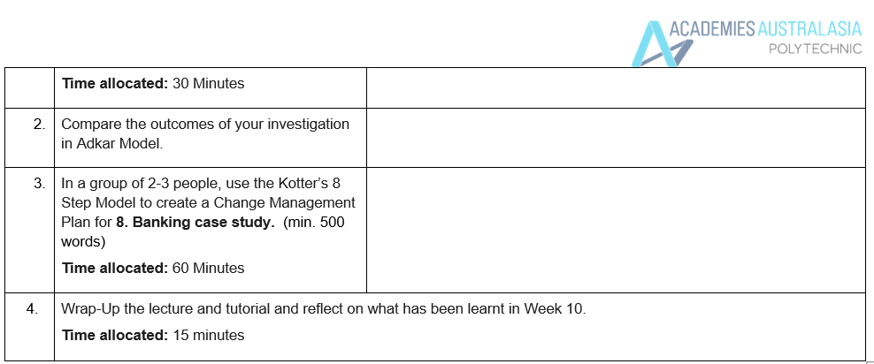

Slide 16
1. Critical Evaluation of Change Management for Hospital ERP System Using Kotter's Model (min. 300 words)
Implementing an ERP system in a hospital setting is a complex undertaking that requires careful change management to ensure a smooth transition. Using Kotter's 8-Step Model, we can critically evaluate how change was managed in the healthcare organization's ERP implementation:
Create a Sense of Urgency: The hospital faced significant challenges with outdated processes that couldn’t support efficient patient care or adapt to healthcare reforms. Establishing the urgency for the ERP system was crucial to ensure compliance and streamlined operations. This sense of urgency could have been more pronounced if communicated as an essential step for improving patient outcomes and reducing errors, making it easier to gain buy-in from employees.

Slide 17
2. Form a Powerful Coalition: The hospital leadership recognized the need for change management as a key component of success. However, forming a coalition of influential leaders, including clinicians, administrators, and IT staff, could have strengthened the change process, ensuring cross-functional support and facilitating smoother integration of the ERP system.
3. Create a Vision for Change: The vision should have focused on improving patient care and enhancing operational efficiency. Clear communication of how the ERP system would align with the hospital's core value of caring for people helped gain employee support. Still, more emphasis on long-term benefits for both staff and patients might have further solidified this vision.

Slide 18
4. Communicate the Vision: The hospital effectively communicated the ERP system's benefits to align with its culture. However, consistent messaging across all departments and using multiple channels (emails, town hall meetings, etc.) could have ensured that the vision reached all levels of the organization.
5. Empower Broad-Based Action: Addressing barriers, such as resistance from staff and integrating change management into leadership roles, empowered employees to embrace the ERP system. However, providing additional training and support to those struggling with the change would have improved the adaptation process.

Slide 19
6. Generate Short-Term Wins: The hospital focused on implementing the ERP system in stages, allowing for incremental successes, such as improved patient record management. Celebrating these wins publicly encouraged staff to continue supporting the change process.
7. Consolidate Gains and Produce More Change: After the initial successes, the hospital needed to maintain momentum by applying change management strategies to other IT initiatives. Continuous reinforcement ensured that employees remained engaged with the new system.

Slide 20
8. Anchor New Approaches in the Culture: Integrating change management as a leadership competency was crucial in ensuring the ERP system became part of the hospital's everyday operations. However, regular feedback loops could have ensured the system's long-term success and adaptation.
Overall, applying Kotter's model highlighted the importance of aligning change initiatives with the hospital's values, enabling smooth and successful implementation.

Slide 21
2. Comparison with the ADKAR Model
The ADKAR Model (Awareness, Desire, Knowledge, Ability, and Reinforcement) offers a different perspective on managing change compared to Kotter's model. In the case of the hospital's ERP implementation:
Awareness: Both models emphasize creating awareness. In Kotter's model, it's about creating urgency, while ADKAR focuses on ensuring employees understand why the change is necessary. The hospital effectively communicated the need for an ERP system, making staff aware of the impending healthcare reforms.

Slide 22
Desire: ADKAR emphasizes building a desire to support the change, which aligns with Kotter's steps of forming a coalition and communicating the vision. The hospital could have further built desire by involving more staff in the change process, ensuring they saw the benefits firsthand.
Knowledge: Providing knowledge is critical in ADKAR, ensuring employees know how to adapt to the change. This corresponds with Kotter's step of empowering action. The hospital's training sessions were a step in the right direction, but more comprehensive support could have been offered.

Slide 23
Ability: Kotter's model focuses on generating wins and consolidating gains, while ADKAR emphasizes enabling employees to act. The hospital addressed this by integrating change management into leadership roles, helping staff adapt their skills to the ERP system.
Reinforcement: Both models stress the importance of reinforcing change. While Kotter anchors change in culture, ADKAR focuses on maintaining support to prevent reverting to old habits. The hospital's strategy of integrating change leadership helped sustain this momentum.

Slide 24
3. Group Activity: Using Kotter's 8-Step Model to Create a Change Management Plan for Banking Case Study (min. 500 words)
Change Management Plan for Banking Case Study Using Kotter’s 8-Step Model:
Create a Sense of Urgency: The major Canadian bank must address the need for standardizing change management practices to prevent inefficiencies caused by inconsistent methods. Analyzing the potential risks, such as regulatory non-compliance and financial losses, can establish a strong sense of urgency among employees and stakeholders. This urgency can be reinforced by sharing examples of how standardized change management can improve efficiency and customer satisfaction.

Slide 25
2. Form a Powerful Coalition: Form a team of influential leaders from different business units, including IT, customer service, and compliance departments, to champion the change. These leaders should be individuals who have experience in managing change and can communicate the vision effectively, ensuring all departments see the value in adopting standardized practices.

Slide 26
3. Create a Vision for Change: Develop a clear vision that emphasizes the benefits of standardizing change management, such as improved efficiency, compliance, and a unified approach to handling changes across the bank. For example, the vision could be: "Creating a seamless change management process to enhance our banking services, ensuring compliance, efficiency, and excellent customer experience."

Slide 27
4. Communicate the Vision: Communicate the vision across the organization using various channels such as emails, town hall meetings, and the intranet. Ensure that the communication is frequent, transparent, and addresses any concerns employees might have. Highlight success stories from other banks or industries to demonstrate the positive impact of standardized change management.

Slide 28
5. Empower Broad-Based Action: Identify and remove any obstacles that may hinder the change process. For example, if employees lack knowledge of change management practices, provide training sessions or workshops to equip them with the necessary skills. Encourage employees to share their experiences and suggestions for improving change management, fostering a sense of ownership.

Slide 29
6. Generate Short-Term Wins: Implement small pilot projects where standardized change management practices can be applied. For instance, choose a department or project where changes are frequent and showcase how standardization improves efficiency. Recognize and celebrate these early successes to build momentum and encourage others to adopt the new practices.

Slide 30
7. Consolidate Gains and Produce More Change: Use the momentum from the initial successes to drive further change. Apply standardized change management practices to larger projects or across more business units. Continuously monitor progress and address any resistance or challenges that arise, ensuring that employees remain engaged and motivated.

Slide 31
8. Anchor New Approaches in the Culture: Embed change management into the bank's culture by integrating it into job roles, training programs, and performance evaluations. Encourage leaders to model the new behaviors and practices, demonstrating their commitment to the change. Over time, change management will become a natural part of the bank’s operations, ensuring long-term success and adaptability.

Slide 32
By following Kotter’s 8-Step Model, the Canadian bank can create a comprehensive change management plan that encourages a consistent, unified approach across the organization, leading to improved efficiency, compliance, and customer satisfaction.

Slide 33
Group Class Activity 1: Change Management at Telstra
Task: In groups of 2-3, prepare a PowerPoint presentation on how Telstra managed a significant change in their organization (e.g., implementing a new technology or process). Apply the Change Management Principles discussed in the lecture.
Instructions:
Research a real-life change initiative Telstra has undertaken.
Identify how Telstra planned, communicated, trained employees, and minimized disruptions during this change.
Include how they dealt with resistance and what lessons were learned.

Slide 34
Group Class Activity 1
Presentation Points:
Overview of the change
Application of change management principles
Challenges faced and how they were overcome
Key takeaways and recommendations

Slide 35
Group Class Activity 2: IT Governance at Commonwealth Bank
Task: Create a presentation about how Commonwealth Bank ensures IT governance in implementing online banking features or other digital innovations.
Instructions:
Research Commonwealth Bank's IT governance practices.
Discuss how they align IT projects with business goals, manage risks, measure performance, and ensure compliance.
Provide examples of successful IT projects where governance played a crucial role.

Slide 36
Group Class Activity 2: IT Governance at Commonwealth Bank
Presentation Points:
Overview of Commonwealth Bank’s IT governance framework
Key principles applied in a recent IT project
Success factors and challenges
Recommendations for improving IT governance

Slide 37
Group Activity 3: Applying Kotter’s 8-Step Model at Sydney Water
Task: Develop a presentation on how Sydney Water could use Kotter’s 8-Step Model to implement an automated billing system successfully.
Instructions:
Describe each of Kotter’s 8 steps and how Sydney Water can apply them in this change process.
Highlight potential resistance and strategies to address it using Kotter’s model.

Slide 38
Group Activity 3: Applying Kotter’s 8-Step Model at Sydney Water
Presentation Points:
Overview of Kotter’s 8-Step Model
Application of each step to Sydney Water’s billing system change
Potential challenges and solutions
Expected outcomes

Slide 39
Group Activity 4: Overcoming Resistance to Change at Qantas Airways
Task: Prepare a presentation on strategies Qantas Airways could use to address resistance when introducing a new scheduling software.
Instructions:
Identify common reasons for resistance among Qantas employees.
Develop a plan for addressing these concerns, including communication strategies, training, and involvement.
Use real examples from Qantas or other airlines to support your recommendations.

Slide 40
Group Activity 4: Overcoming Resistance to Change at Qantas Airways
Presentation Points:
Overview of the new scheduling software implementation
Common reasons for resistance at Qantas
Strategies to overcome resistance
Expected benefits of successful change management

Slide 41
Group Activity 5: Comparing Change Management Models - Australia vs. USA
Task: Select a company in Australia (e.g., Telstra, Commonwealth Bank) and compare its change management practices to a similar company in the USA (e.g., AT&T, Bank of America) using the Kotter and ADKAR models.
Instructions:
Research change initiatives in both companies.
Compare how each company used the Kotter and ADKAR models.
Highlight key similarities, differences, and lessons learned.

Slide 42
Group Activity 5: Comparing Change Management Models - Australia vs. USA
Presentation Points:
Overview of change initiatives in both companies
Comparison of Kotter and ADKAR model applications
Successes, challenges, and lessons learned
Recommendations for future change initiatives

Slide 43

Thank You!
These activities encourage you to apply theoretical concepts to real-world scenarios, enhancing your understanding of change management and IT governance in different organizational contexts.

